Slide 1
CAPSTONE PROJECT
USED CARS MARKET ANALYSIS

Slide 2
OBJECTIVE: TO Analyze the used cars available in the market based on multiple parameters.

Slide 3
DATA PREPARATION
 | Bengaluru | Chennai | Delhi | Hyderabad | Mumbai
Row Count | 1282 | 548 | 1868 | 722 | 648
Column Count | 11 | 11 | 11 | 11 | 11
Duplicate Row count | 0 | 0 | 0 | 0 | 0
Duplicate Column count | 0 | 0 | 0 | 0 | 0
New row count after duplicate removal | 1282 | 548 | 1868 | 722 | 648

Slide 4
DATA ANALYSIS
 | Driven km | Price | EMI Rs
Count | 5062 | 5062 | 5062
Unique Count | 4949 | 1109 | 1109
Min | 0.00 | 121000.00 | 2366.00
Mean | 54392.78 | 581871.93 | 11288.01
Std Deviation | 28065.75 | 276565.82 | 5236.57
25th percentile | 32162.75 | 392000.00 | 7664.00
Median | 52227.50 | 534000.00 | 10440.00
75th percentile | 74052.75 | 709000.00 | 13861.00
Max | 149549.00 | 2212000.00 | 42103.00

Slide 5
Fuel type | Count | Percent of total count
Petrol | 4150 | 81.89
Diesel | 639 | 12.61
CNG | 278 | 5.49
LPG | 1 | 0.02
Gear Type | Count | Percent of total count
Manual | 3952 | 77.98
Automatic | 1116 | 22.02
Fuel type | Count | Percent of total count
1 | 3555 | 70.15
2 | 1361 | 26.85
3 | 151 | 2.98
4 | 1 | 0.02

Slide 6
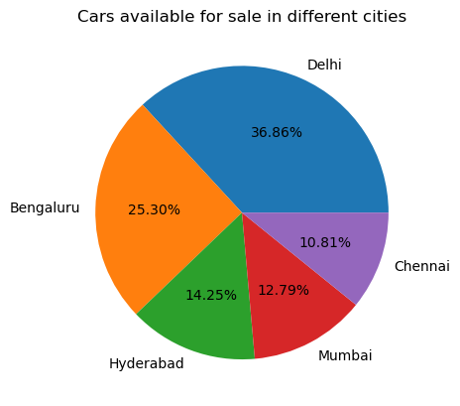
Percentage of Used Cars in Different Cities
The chart above is depicting that most of the used cars are available for sale in Delhi and least in Chennai.
The cars for sale in Chennai, Hyderabad and Mumbai are nearly equal.

Slide 7
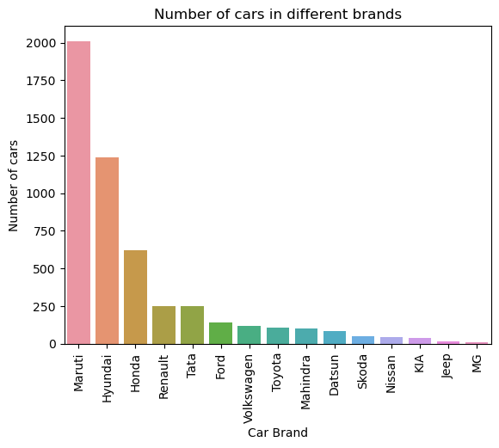
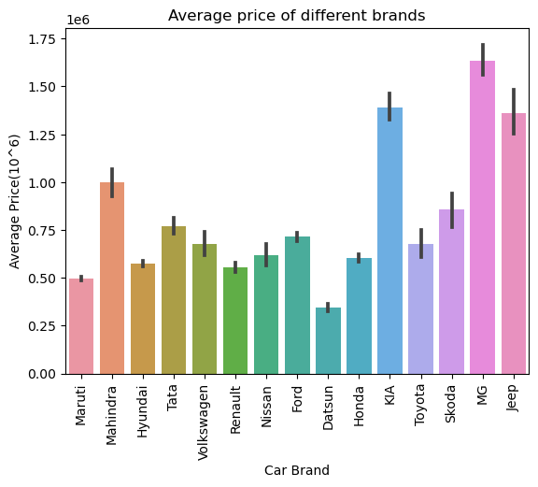
No of cars and average price of different brands
It is interpreted that Maruti Car Brand is the most available used car brand may be because of low price as can be seen in next graph and MG Car Brand is the least available due to high price.

Slide 8
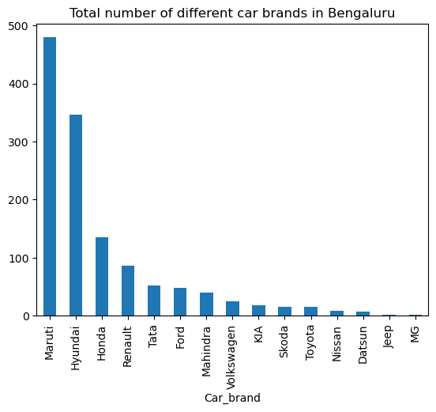
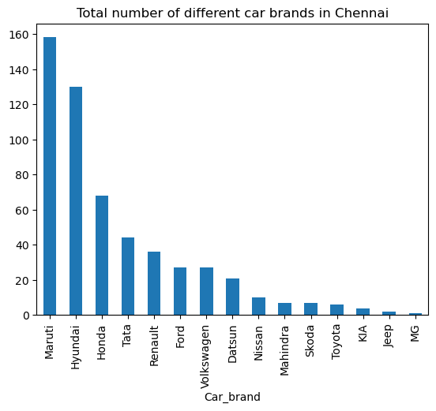
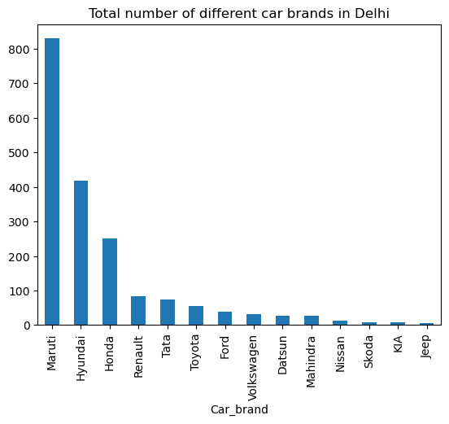
Total number of different car brands in each city

Slide 9
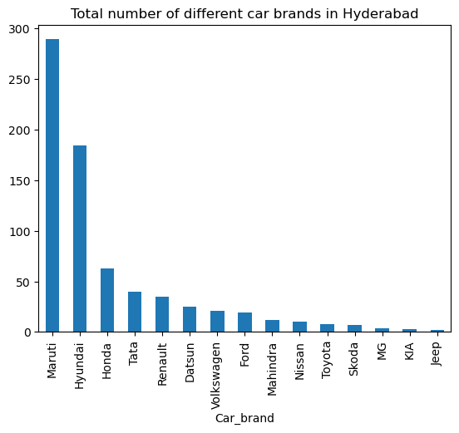
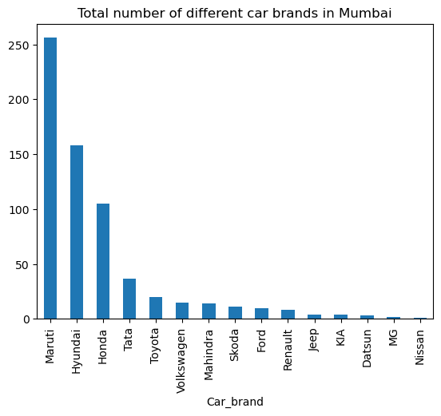
In each of the five city, Maruti Car Brand is available for sale the most followed by Hyundai and then Honda.
The used Car brands like MG, KLA, Jeep has very less availability compared to other car brands.

Slide 10
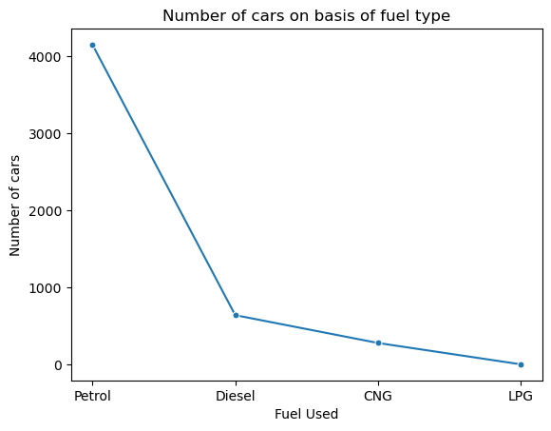
No of cars based on fuel type
There is a gradual decrease from number of cars driven by Diesel to that by CNG and from CNG driven cars to LPG driven cars.
Number of cars driven by petrol are extremely high compared to others.

Slide 11
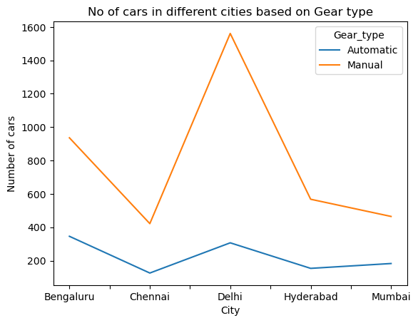
No of cars based on Gear type
The maximum number of cars available for sale in each city has manual gear type.
Chennai, Hyderabad and Mumbai have almost equal number of automatic gear type cars as well as manual gear type cars.
The number of automatic gear type cars in Bengaluru and Delhi are nearly equal while there is a high difference in the number of manual gear type cars in Bengaluru and Delhi.

Slide 12
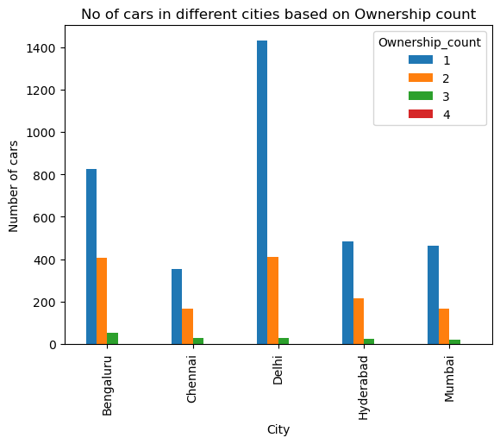
No of cars based on Ownership Count
The used cars are mostly in sale by 1st owner followed by 2nd.
Very few cars are in sale by 3rd owner and negligible by 4th.
There is a large difference between number of cars available for sale by 1st owner and 2nd owner and 3rd owner in Delhi.

Slide 13
The car model XZA PLUS GOLD with the price of 2212000 is the most expensive car for sale.
Gear type: Automatic
Driven km: 48686
Fuel type: Diesel
Car City: Bengaluru
Car Brand: Tata
Model Year: 2022
Ownership: 1st Owner
EMI Rs: 42103

Slide 14
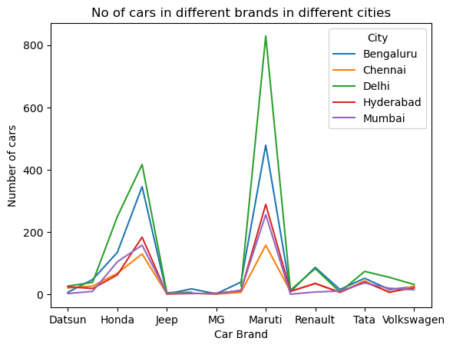
No of cars in different brands available in different cities

Slide 15
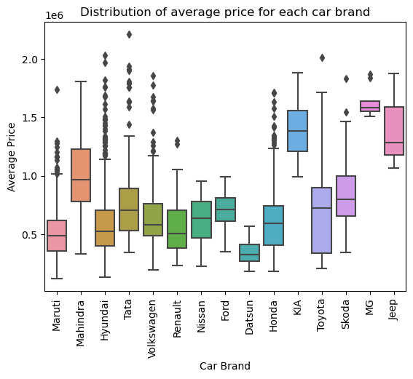
Box Plot of average price for each car brand
The average price of MG Car brand is highest while the average price of Maruti car brand is least.
There are large number of outliers for Car brands Maruti, Hyundai, Tata, Volswagen and Honda i.e. average price of some of these cars(of each car brand) are relatively higher than other cars of the same brand.
The average price of KLA, MG and Jeep Car brands for sale is above 1 lakhs.

Slide 16
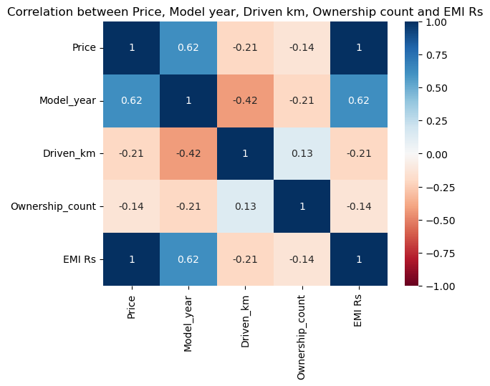
Correlation Matrix with Heat Map
There is no relationship between variables when the correlation coefficient is 0.
The relationship gets stronger as Correlation coefficient approaches 1 or -1 from 0.

Slide 17
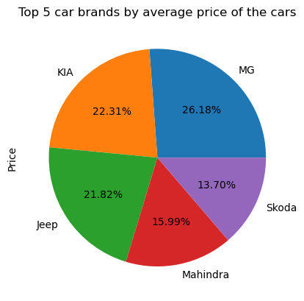
Top 5 expensive car brands
MG, KLA, Jeep, Mahindra and Skoda have the maximum average price of cars which are available for sale.

